Slide 1
15-213 Recitation: C Review
Ben Spinelli
Recitation 6: 5 October 2015

Slide 2
Agenda
Attack Lab
C Exercises
C Conventions
C Debugging
Version Control
Compilation
Demonstration

Slide 3
Attack Lab...
is due Thursday. Start now if you haven’t yet.

Slide 4
Some warnings about C
It’s possible to write bad code. Don’t.
Watch out for implicit casting.
Watch out for undefined behavior.
Watch out for memory leaks.
Macros and pointer arithmetic can be tricky.
K&R is the official reference on how things behave.

Slide 5
C-0
int foo(unsigned int u) {
return (u > -1) ? 1 : 0;
}

Slide 6
C-0
int foo(unsigned int u) {
return (u > -1) ? 1 : 0;
}
-1 is cast to an unsigned int in the comparison, so the comparison that is happening is actually u > int_max.
This always returns 0.

Slide 7
C-1
int main() {
int* a = malloc(100*sizeof(int));
for (int i=0; i<100; i++) {
a[i] = i / a[i];
}
free(a);
return 0;
}

Slide 8
C-1
int main() {
int* a = malloc(100*sizeof(int));
for (int i=0; i<100; i++) {
a[i] = i / a[i];
}
free(a);
return 0;
}
No value in a was initialized. The behavior of main is undefined.

Slide 9
C-2
int main() {
char w[strlen("C programming")];
strcpy(w,"C programming");
printf("%s\n", w);
return 0;
}

Slide 10
C-2
int main() {
char w[strlen("C programming")];
strcpy(w,"C programming");
printf("%s\n", w);
return 0;
}
strlen returns the length of the string not including the null character, so we end up writing a null byte outside the bounds of w.

Slide 11
C-3
struct ht_node {
int key;
int data;
};
typedef struct ht_node* node;
node makeNnode(int k, int e) {
node curr = malloc(sizeof(node));
curr->key = k;
curr->data = e;
return curr;
}

Slide 12
C-3
struct ht_node {
int key;
int data;
};
typedef struct ht_node* node;
node makeNnode(int k, int e) {
node curr = malloc(sizeof(node));
curr->key = k;
curr->data = e;
return curr;
}
node is a typedef to a struct ht_node pointer, not the actual struct. So malloc could return 4 or 8 depending on system word size.

Slide 13
C-4
char *strcdup(int n, char c) {
char dup[n+1];
int i;
for (i = 0; i < n; i++)
dup[i] = c;
dup[i] = ’\0’;
char *A = dup;
return A;
}

Slide 14
C-4
char *strcdup(int n, char c) {
char dup[n+1];
int i;
for (i = 0; i < n; i++)
dup[i] = c;
dup[i] = ’\0’;
char *A = dup;
return A;
}
strcdup returns a stack-allocated pointer. The contents of A will be unpredictable once the function returns.

Slide 15
C-5
#define IS_GREATER(a, b) a > b
inline int isGreater(int a, int b) {
return a > b ? 1 : 0;
}
int m1 = IS_GREATER(1, 0) + 1;
int m2 = isGreater(1, 0) + 1;

Slide 16
C-5
#define IS_GREATER(a, b) a > b
inline int isGreater(int a, int b) {
return a > b ? 1 : 0;
}
int m1 = IS_GREATER(1, 0) + 1;
int m2 = isGreater(1, 0) + 1;
IS_GREATER is a macro that is not wrapped in parentheses. m1 will actually evaluate to 0, since
1 > 0+1 = 0.

Slide 17
C-6
#define NEXT_BYTE(a) ((char*)(a + 1));
int a1 = 54; // &a1 = 0x100
long long a2 = 42; // &a2 = 0x200
void* b1 = NEXT_BYTE(&a1);
void* b2 = NEXT_BYTE(&a2);

Slide 18
C-6
#define NEXT_BYTE(a) ((char*)(a + 1));
int a1 = 54; // &a1 = 0x100
long long a2 = 42; // &a2 = 0x200
void* b1 = NEXT_BYTE(&a1);
void* b2 = NEXT_BYTE(&a2);
b1 is a void pointer to the address 0x104.
b2 is a void pointer to the address 0x208.

Slide 19
C Workshop
If you had trouble with the previous exercises, go!!!
Saturday, October 10 in the afternoon. Details TBA.
Material:
Undefined behavior, casting
Structs, pointers
Memory management
Standard library functions
Random stuff: macros, typedefs, function pointers, header guards… and anything else you have questions on!

Slide 20
The C Standard Library
#include <stdlib.h>
Use it. It is your friend!
Don’t write code that’s already been written!
Your work might have a bug or lack features
All C Standard Library functions are documented.
Use the UNIX man command to look up usage

Slide 21
Robustness
Code that crashes is bad.
Avoid making bad things!
Don’t write code with undefined behavior
Check for failed system calls and invalid input
Some errors should be recoverable, others not
Proxy Lab is an excellent example of this
Free memory that you allocate
Leaky code will crash (and code that crashes is bad!)
Memory leaks will cost you style points

Slide 22
Robustness: Continued
CSAPP wrappers check return values of system calls
Terminate program when error is encountered
Malloc, Free, Open, Close, Fork, etc.
Super duper useful for Proxy & Shell Labs
Alternatively, check for error codes yourself
Useful when you don’t want program to terminate
FILE *pfile; // file pointer
if (!(pfile = fopen(“myfile.txt”, “r”))) {
printf(“Could not find file. Opening default!”);
pfile = fopen(“default.txt”, “r”);
}

Slide 23
Quick C Tip: getopt
Used for parsing command-line arguments
Don’t write your own code for this. Not worth it.
In fact, we actively discourage it
Autograder randomizes argument order
Try it: man getopt

Slide 24
Style Points
We read and grade your code for style
Style guide: http://cs.cmu.edu/~213/codeStyle.html
Vim macro to highlight lines longer than 80 cols:
2mat ErrorMsg '\%80v.'
Emacs users… :
(setq whitespace-style '(trailing lines space-before-tab indentation space-after-tab) whitespace-line-column 80)
View your annotated code on Autolab

Slide 25
gdb
Step through C code side-by-side with Assembly
Print variables, not just registers and addresses!
Break at lines, not just addresses and functions!
gdbtui <binary> is gdb with a less-breakable user interface.
Nice for looking at your code during execution
Type layout split to view Assembly alongside

Slide 26
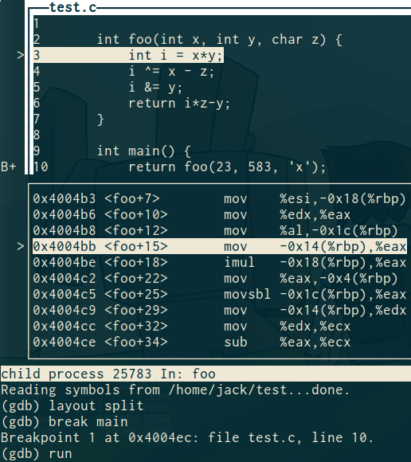
gdbtui

Slide 27
valgrind
Best tool for finding...
Memory leaks
Other memory errors (like double frees)
Memory corruption
Use gcc with -g to give you line numbers of leaks
Use valgrind --leak-check=full for thoroughness

Slide 28
Version Control: Your Friend
You may find it useful to use version control if you are already familiar with it
If not, that’s okay, it’s not required. Making regular submissions to Autolab can act as a checkpointing system too.

Slide 29
gcc
GNU Compiler Collection
Is a C compiler, among other things
We will give you instructions for compilation in handouts
man gcc if you’re having trouble

Slide 30
make
Lab handouts come with a Makefile
Don’t modify them
You write your own for Proxy Lab
Examples for syntax found in previous labs
make reads Makefile and compiles your project
Easy way to automate tedious shell commands

